Slide 1


Real-time Patient Flow Management
Liam Peyton
lpeyton@uottawa.ca

Slide 2
Project Collaboration
Osler
Joanne Flewwelling, VP & CIO Strategic Information and Performance Systems
Alain Mouttham: Clinical Researcher
uOttawa
Alain Mouttham: Project Leader
Students: Renaud Bougueng Tchemeube, Shirley Baffoe, Sepideh Bahrani, Aladdin Baarah, Amanpal Bhatia, Curtis Naphan, Ruogu Luo, Gurpreet Dhadda, Austin Chamney
PostDocs: Omar Badreddin, Saeed Benham
Professors: Liam Peyton, Daniel Amyot
IBM
Randy Giffen (Paul Sulkers, Marcellus Mindel)
MITACS, BIN NSERC Strategic Network, Telfer CBAP, ORF

Slide 3
Problem Statement
In Ontario, large community hospitals and teaching hospitals operate near congestion level most of the time
Bed occupancy levels near or above 100%
Very long wait times for admitted ED patients: 20+ hours
Procedure cancellations: hundreds per year
Patient off-servicing
Ambulances unable to offload
In such environment, any small variation in patient arrivals and/or hospital capacity can trigger large variation in wait times
Decisions to improve the patient flows are usually made manually, with some delay, based on incomplete data, unit per unit, in an ad hoc manner
This leads to a resolution strategy which may be best for the unit, but not necessarily optimized for the entire hospital

Slide 4
Real-time Analytics, at 15:00

Slide 5
Objectives
Patient flow management to identify and analyze bottlenecks
track patient flows to address wait-times and root causes.
wait-times can be caused by problems further downstream
Real-time dashboard for event monitoring and analytics
Current state of patients and beds and their event history
Hourly and historical trends of key metrics
Alerts for out-of-bound metrics and states
Architecture for integrating emerging information technology
complex event processing and real-time analytics
business process modelling
Real-time location services using RFID tags

Slide 6
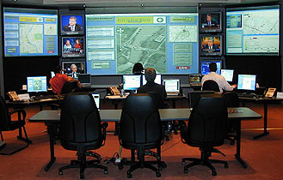
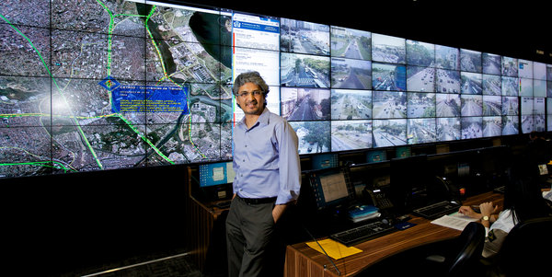
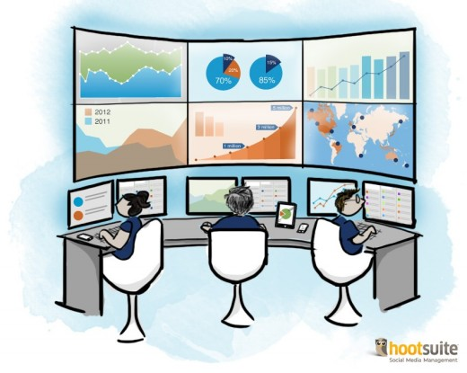
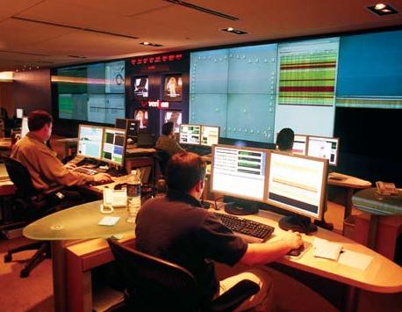
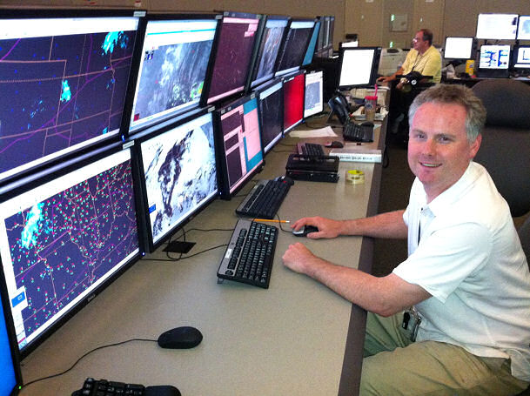
Command Center Paradigm!

Slide 7
Methods
Case study of cardiac patient flow at large community hospital
Gap analysis of existing and available information technology
Data model of relevant metrics, states, & alerts correlated with event triggers from wide spectrum of data sources in hospital
Prototyped real-time monitoring and analytics dashboard using proposed architecture for information technology integration
Prototype evaluated using simulations based on historical data

Slide 8
Cardiac Patient Flow (Simplified)
Patient Triage
Wait for Consult
Wait for Test
Wait for Consult
Consult1
Wait for Discharge
Wait for Bed
Discharge
Procedure
Consult2
Business Process Management (BPM) engine, Real-Time Location Service (RTLS), Hospital Information Systems (HIS)
Key states and wait times for patients
Patient transportation, room housekeeping etc. not included in this diagram
Other processes as well: e.g. bed: available, occupied, waiting for cleanup

Slide 9
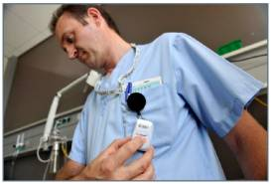
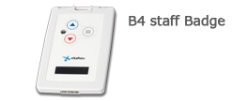
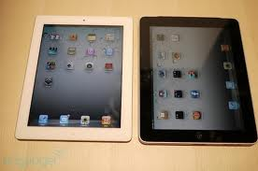
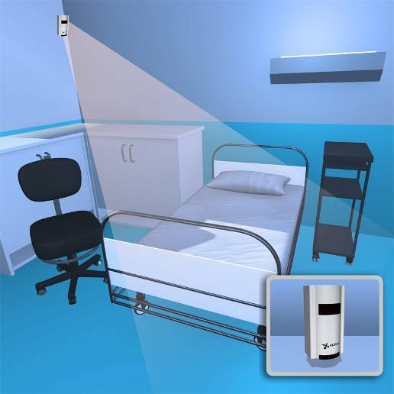
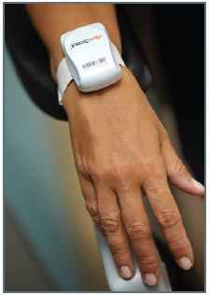
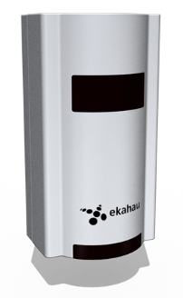
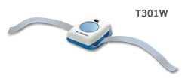
Real-Time Location Service Enabling Technologies
Clinician
Patient
Beacon

Slide 10
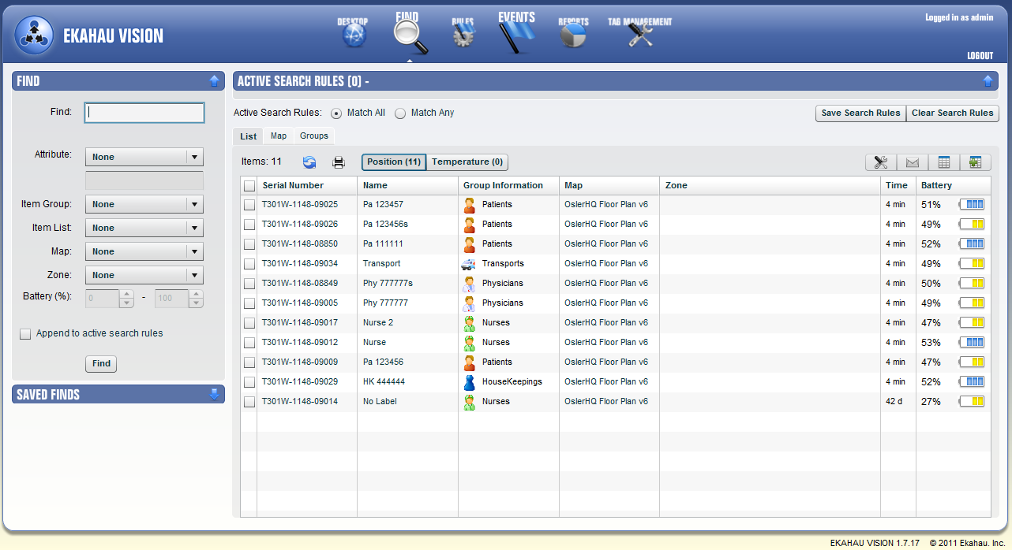

Slide 11
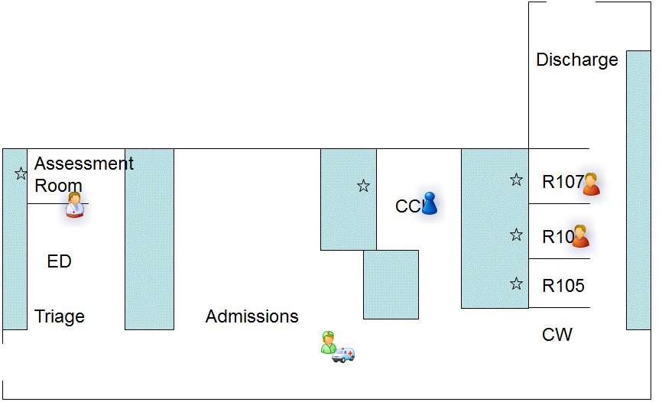
Lab Map (Ikahau Screen Capture)

Slide 13
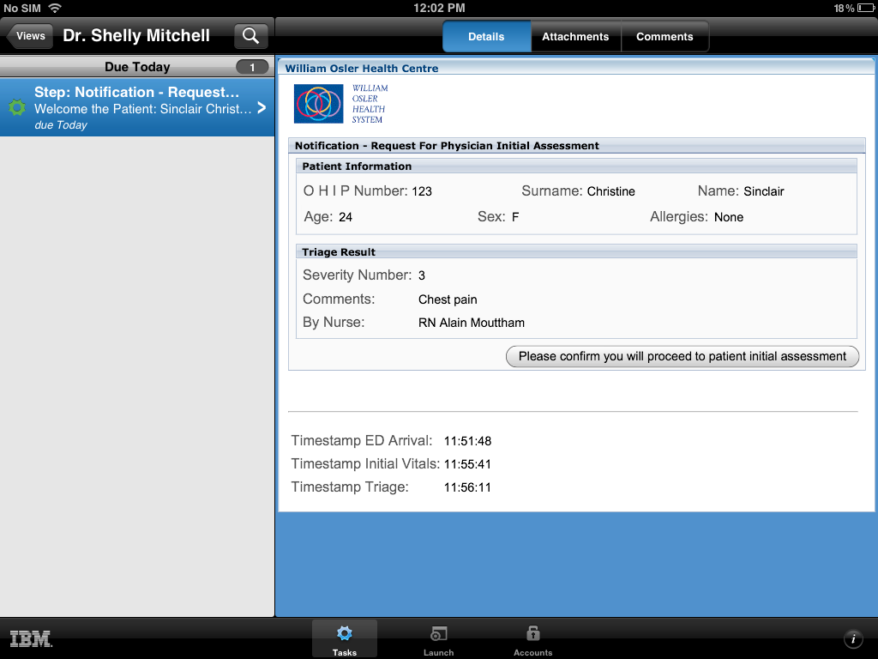
iPad version!

Slide 14
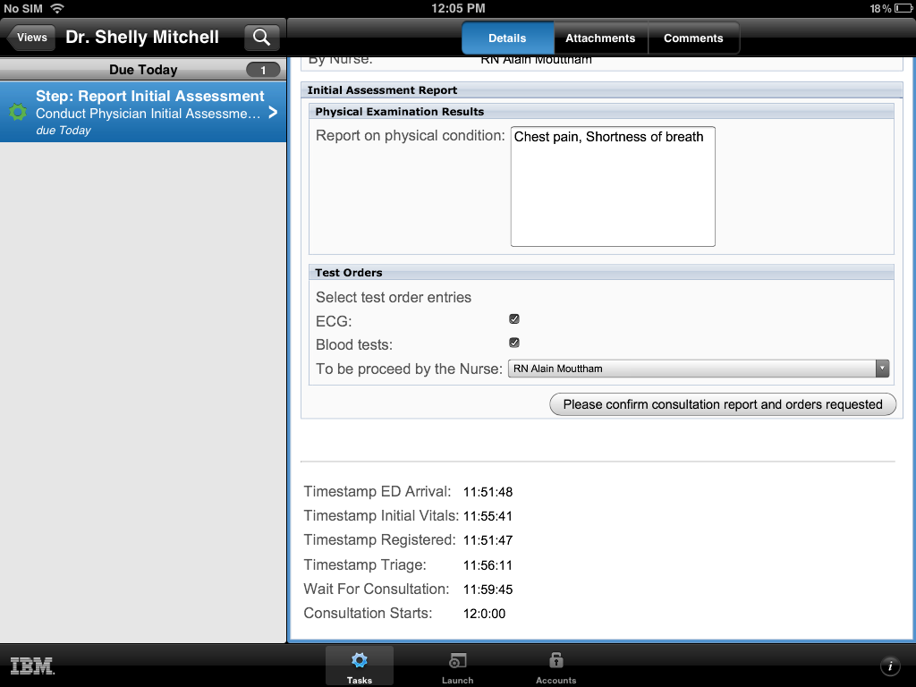

Slide 15
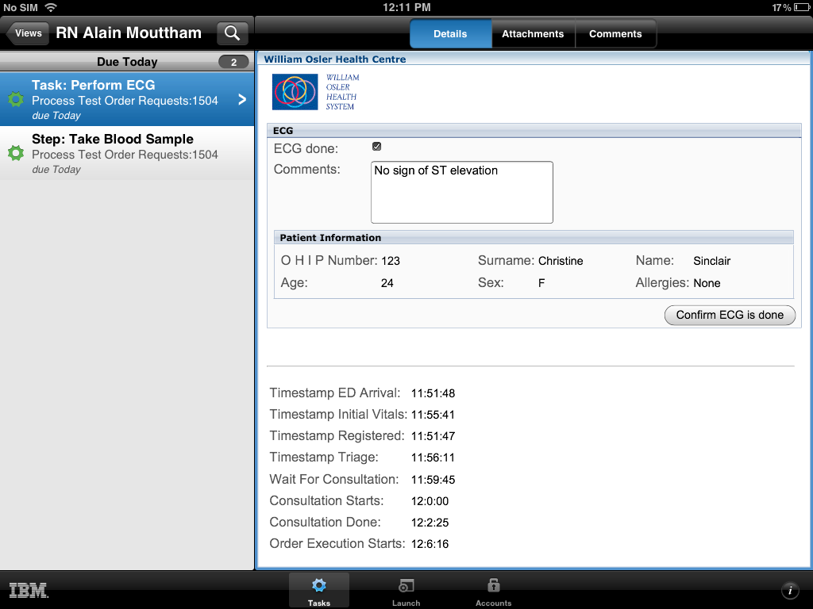

Slide 16
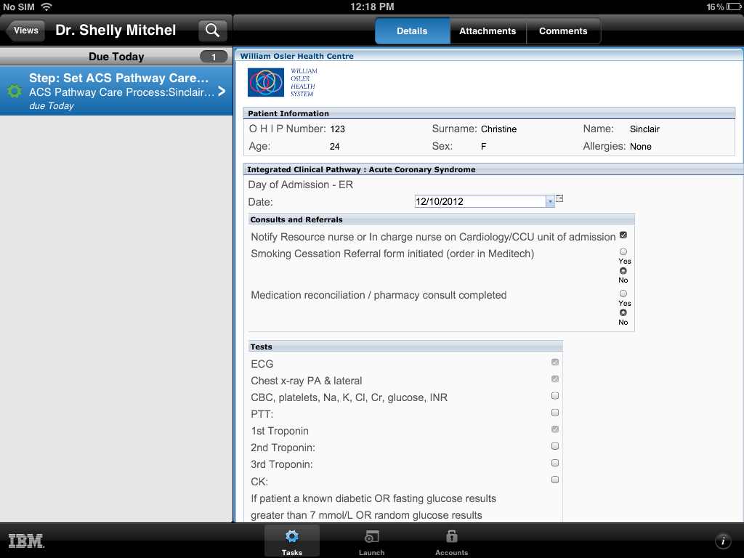

Slide 18
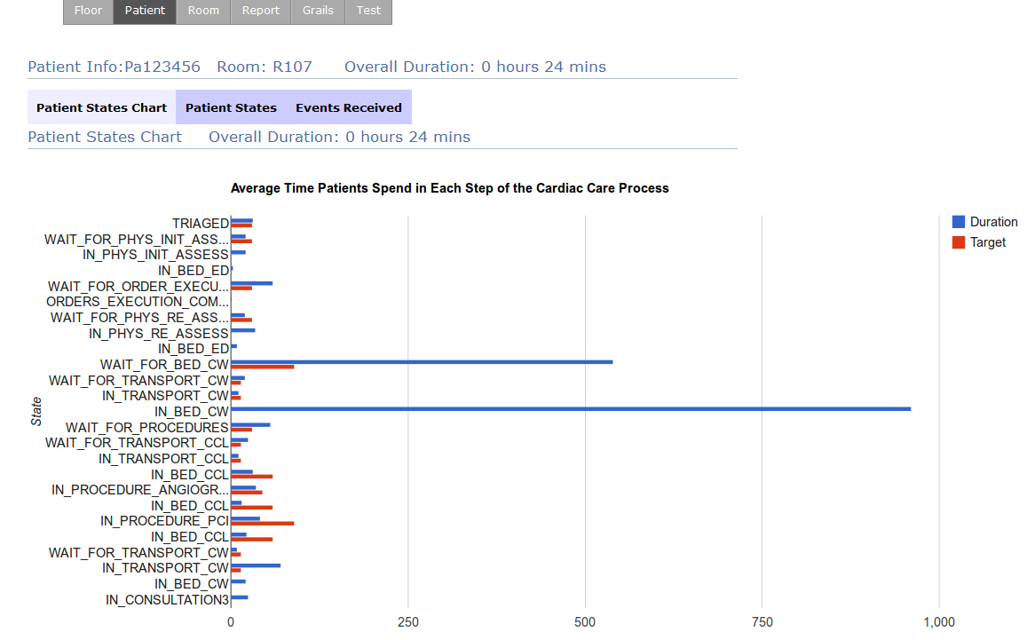
Wait Times and Service Times Display

Slide 20
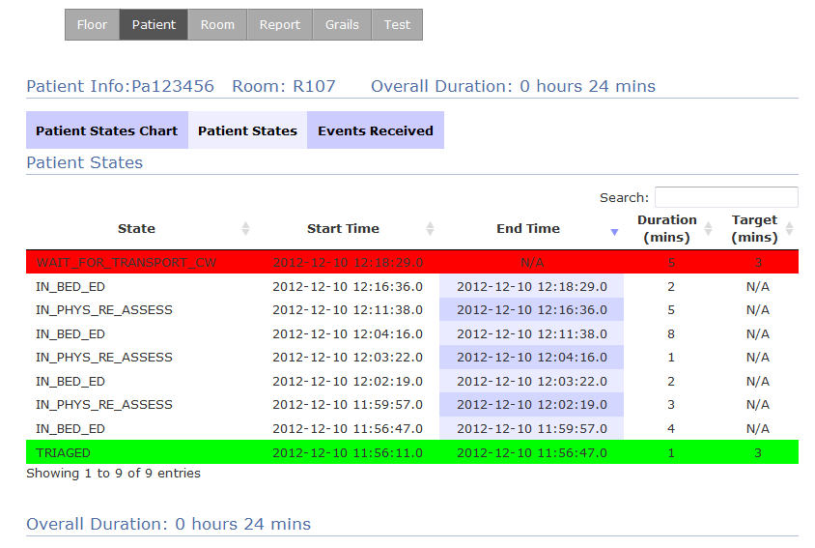
Tracking States for a Patient

Slide 21
Results & Conclusions(lab)
Existing Hospital Infrastructure for reporting
traditional data architectures took days to correlate data from EHR and myriad data silos
Prototype
processed events in seconds
provided real-time monitors of patient flow and care process states.
Technology Gaps
BPM and RTLS each provide data in real-time
CEP integrates both and infers new data

Slide 22
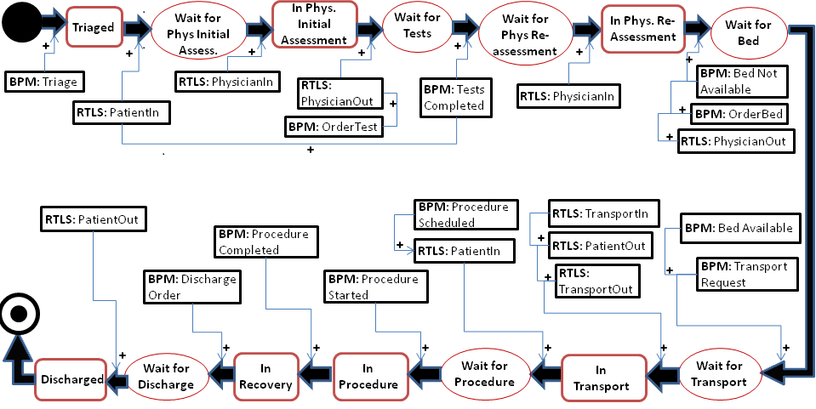
Application Model for ACS Monitoring

Slide 23
Compare Technologies (Patient States)
Care Process State | Accurate Monitoring by Technology
 | BPM | RTLS | Integrated
WaitForPhyInitAss Discharge | No | Yes | Yes
WaitForTests WaitForBed Procedure | Yes | No | Yes
WaitForPhyReAss WaitForTransport WaitForDischarge | No | No | Yes

Slide 24
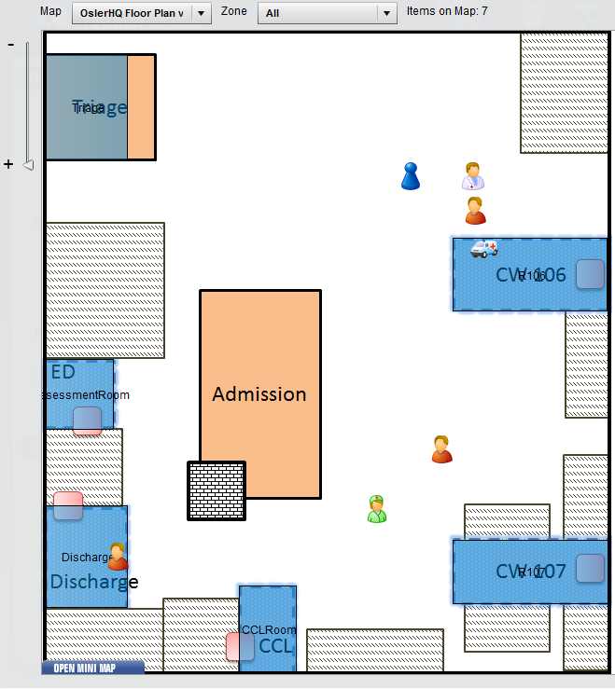
Map for simulation trial at William Osler Hospital

Slide 25
Simulation and Results Osler Hospital, October 2012
12 simulation sessions at William Osler Hospital (Brampton) with clinicians using the system with “mock” patients
Preliminary results based on 80 respondents
82% consider this technology would improve patient flows and would be better than what exists today
More than 50% believe that the technology should ideally be deployed within the next 2 years
Additional demo to a dozen field personnel from IBM
Extremely positive across the board
First of it’s kind in Canada

Slide 26
Future Work
BPM: Tolerance to exceptions and out-of-sequence actions
RTLS: Tolerance to location noise
Monitoring: Generic state definition / monitoring
Simulation: Short-term simulations for hourly decision making
Integration with hospital information systems
Analysis of decision support system

Slide 27
Questions?

